Slide 1
Technical KPI for MVS3G SX11
Sys Team

Slide 2
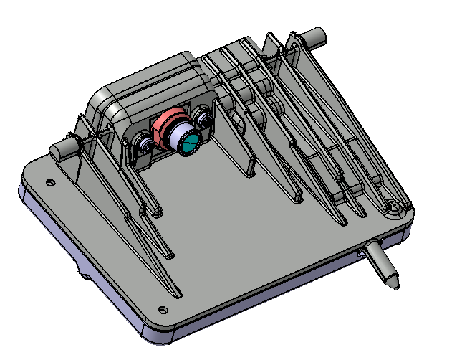
MVS - Mono Vision Camera Generation 3
Light traps integrated in bracket or attached to camera housing
Static calibration EOL optional. Dynamic calibration during driving
MVS3G uses extra CAN bus and larger micro-controller
Key Item | MVS3G
Imager | 1.2MP Sensor ON Semi
Field-of-View (horizontal) | 47°
Color | RGB
Camera Configuration | Mono
Camera update rate | 22Hz (45ms)
Vision Processor (VP) | Xilinx - Zynq Ultrascale ZU3
RAM / Flash @ VP | LPDDR4 / Flash
Micro controller (MCU) | Infineon Aurix 29
Vehicle communication | CAN + CAN
Connector | Tyco (TBC)
FuSa Level | ASIL - B
MVS3G
MVS3G Dimensions:
Width ~99 mm
Depth ~77 mm
Height ~33 mm

Slide 3
MVS3G Hardware Block Diagram
Xilinx ZU3 MPSoC
Infineon TC29x
FPGA
MCU
Flash memory
Camera
SPI
RAM
VP2
Cortex-R5 (2x)
VP1
Cortex-A53
(4x)
Peripherals
Vehicle
Peripherals
Flash
LPDDR4

Slide 4
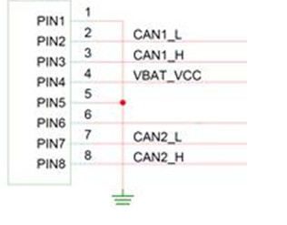
MVS3G Description Key Parameters
Parameter | CVM
Power consumption (nominal) | ~6 W
Weight (preliminary) | ~192 g
Camera dimensions: (W x D x H) | Generic Design 99x77x33mm
Operating Temperature* (Unlimited Operation) | -40 to +85ºC
Operating Temperature* (Network & Diagnostics Operation only) | +85 to +105ºC
* Equivalent Test Chamber Air Temperature

Slide 5
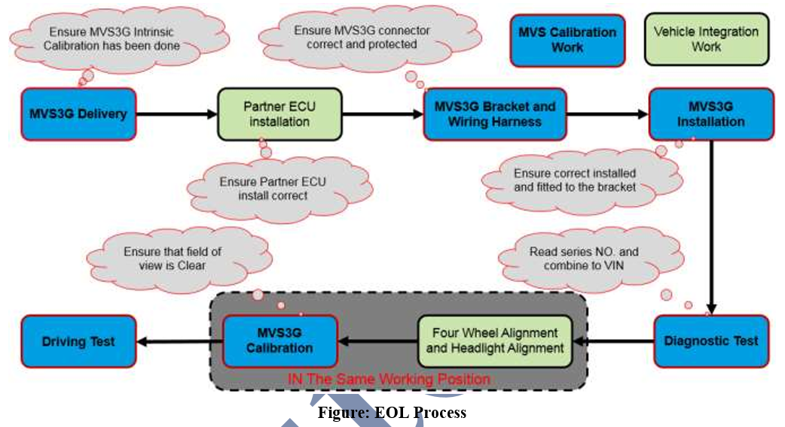
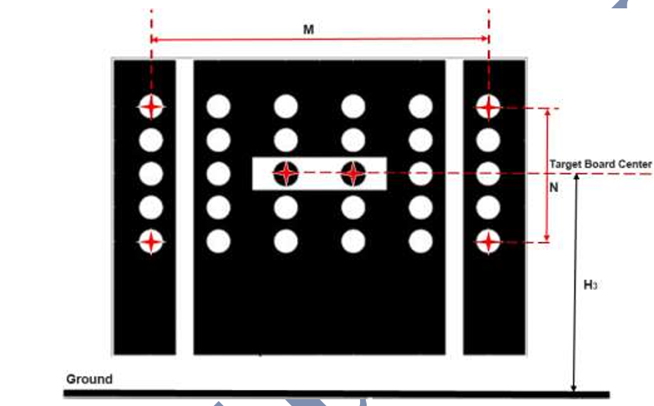
EOL – SeCAL and DeCAL
SeCAL
As SECAL calibration is done, take a drive for 20 minutes with the camera on. This will activate and run dynamic calibration algorithms in the camera. The drive should include different types of roads, traffic and objects. E.g. city, highway, cars, trucks and pedestrians.
DeCAL

Slide 6

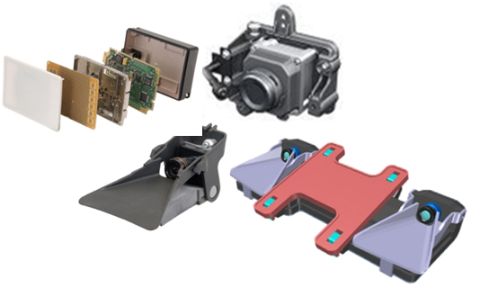

Object Fusion
Object Fusion processes all incoming sensor objects in an intelligent way
Functionaly support
Describe environment surrounding the ego vehicle
Sensor-specific tracking executed by sensor technologies
Independent of sensor type (High flexibility)
Sensor
Data
Fused
Data
FUSION
SitA

Slide 7
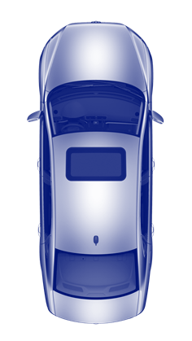
Object Fusion
Object Fusion improvment:
Field of view
Accuracy
Confidence
Stability
Type of information
90°
50°
Fusion objects
Radar objects
Camera objects
18°
Cam only
objects
Fused objects
Radar only objects
Radar FOV
52°
Vision FOV

Slide 8
System Architecture
KL30
KL15
Camera
VLC
(or integrated in ESC)
Front Radar
Radar output: obj. output
Feature: LDW, LKA, SLIF, IHBC, FCW, AEB, ACC, TJA, ICA
Private CAN
Fusion
Camera output:
Lateral control: steering angle request
Longitudinal control: AEB deceleration, ACC deceleration, Engine torque request, other interface signals
Camera input: Vehicle status
Radar Input: Vehicle Statue, ex. vehicle speed, steering angle, yaw rate
Vehicle CAN
EPS
ESC
EMS

Slide 9
System Architecture
Vehicle CAN
Radar Input: Vehicle Statue, ex. vehicle speed, steering angle, yaw rate
Radar Output: Warning indicator
KL30
KL30
Left Rear Corner radar (Slave)
Feature: BSD, LCA, RCTA, SDO
Right Rear Corner radar (Master)
Feature: BSD, LCA, RCTA， SDO
Private CAN

Slide 10
对EMS功能方面的需求
ACC系统控制运行时，对于加速的情况，VLC模块将加速度转换为相应的扭矩需求给EMS，EMS须要响应VLC模块的扭矩请求指令并反馈控制状态。
ACC工作时，EMS响应ACC控制器的指令，一旦ACC系统退出控制，EMS能立即恢复正常工作模式；TCU必须和EMS相匹配，以确保在相应传动比和发动机转速下能发出的最大扭矩、最小扭矩能满足ACC系统需求的扭矩。
EMS不但能响应ACC发出的加速度需求对应的正扭矩需求，且能够响应ACC发出的减速度需求对应的负扭矩需求，以利用发动机拖滞。
如果ACC目标扭矩超过驾驶员请求扭矩，则发动机应响应ACC目标扭矩请求，如果驾驶员请求扭矩超过ACC目标扭矩，则发动机应响应驾驶员扭矩请求。
TCU不同模式下（即驾驶员选择不同的驾驶模式时），EMS响应时间，响应精度都应满足下表所列要求。

Slide 11
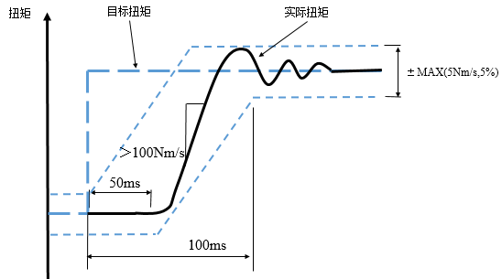
对EMS响应性能方面的需求
项目 | 值
扭矩响应延迟时间 T_{delay} | ≤50ms
扭矩响应时间 T_{delay} + T_{Rampup} | ≤100ms
动态误差 Dynamic error | ±Max（5Nm，目标扭矩 * 10%）
扭矩响应速度 Torque response speed | + 100Nm/s 至 - 500Nm/s
Tdelay ≤
Tdelay + TRampup ≤

Slide 12
对ESC功能方面的需求
对于FCW（碰撞预警）功能，ESC可以执行ADAS发送的点刹制动（Automatic warning brake）请求，并根据请求的不同级别，调节点刹制动的强度。
在紧急情况下，如果驾驶员踩下制动踏板但减速度不足以避免碰撞，EBA会激活并帮助驾驶员避免碰撞。如果驾驶员没有踩制动踏板，AEB会触发。对于EBA以及AEB功能，ESC可以执行ADAS发送的减速度请求。
AEB制动到车静止后，ESC应当使车辆保持在原地不动。
ACC系统控制运行时，对于减速的情况，ESC须要响应减速请求指令并反馈控制状态。
当ACC使车辆减速到接近于静止时，ESC应当缓缓降低制动压力，平稳停车，以保证舒适性， 即soft-stop功能。
在ACC发出车辆驶离请求以后，ESC应当释放制动压力，并且车辆不能后溜。

Slide 13
对ESC响应性能方面的需求
 | 项目 | 值
ACC | 减速度范围 | -4 ~ 3 m/s^2
 | 减速度响应延迟时间 T_{delay}（发出减速度请求到制动系统开始响应） | ≤ 50ms
 | 稳定时间T_{Settling} | ≤ 1 s
 | 动态加速度误差 a_{Dynamic Error} | ≤ 0.25 m/s2
 | 稳态加速度误差a_{SteadyStateError} | ≤ 0.1 m/s^2
AEB | 减速度响应延迟时间 T_{delay}（发出减速度请求到制动系统开始响应） | ≤150ms
 | 制动系统开始建压到高附路面车轮抱死的时间 | ≤350ms
 | 稳态加速度误差a_{SteadyStateError} | ≤ max (0.25 m/s^2, a * 10%)
Deceleration
减速度
a
DynamicError
a
end
a
SteadyStateError
a
t
Settling
SteadyStateError
a
begin
a
Target Deceleration
DynamicError
t
Actual Deceleration
Delay
Time
时间

Slide 14
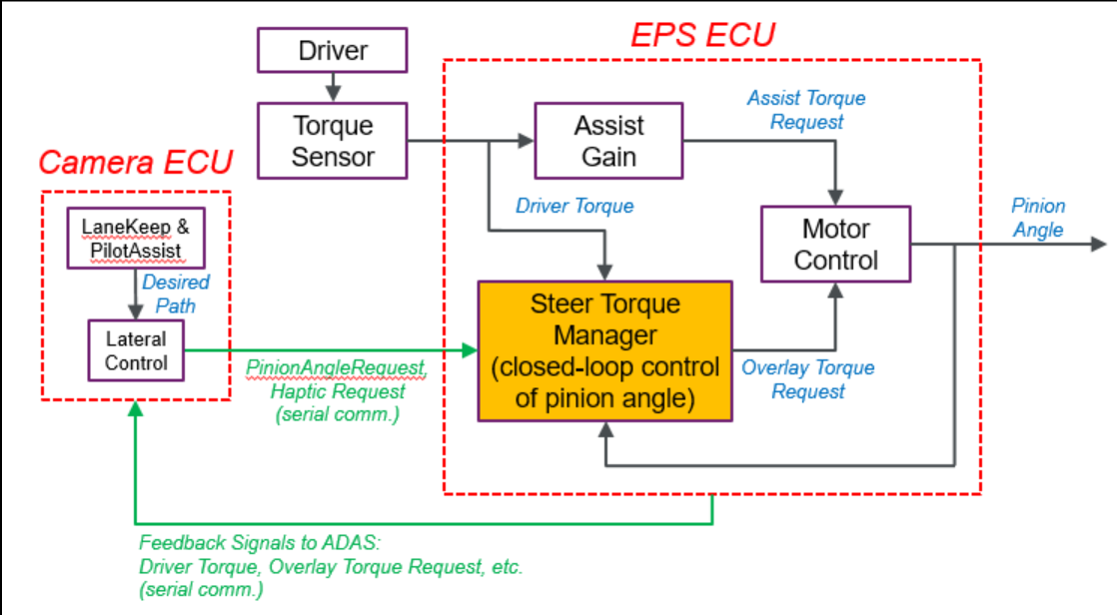
对EPS功能方面的需求
对于横向控制，如LKA, LKS, TJA功能，ADAS发送角度请求(转向器小齿轮转角，pinon angle)给EPS，EPS通过控制EPS助力电机的扭矩输出，达到期望的转角，从而使车辆按照期望的路径行驶。
方向的定义：满足ISO8855 的规定，正值方向应当向左，负值方向应当向右。
ADAS输出的pinion angle请求的更新周期应当不超过25ms
ADAS与EPS的交互逻辑如下图：

Slide 15
对EPS响应性能方面的需求
恒定的Pinion Angle请求
-> 实际的pinion angle误差不超过10%，或者小于1°，两者取大。即，如果请求的pinion angle范围是[-10 ° - 10 °]，则实际误差小于1°，如果请求的pinion angle大于10 °，则实际误差不超过10%
快速变化的Pinion angle请求，比如0.2Hz的正弦输入
-> 响应延迟不超过150ms，偏差不超过10%
快速变化的Pinion angle请求，比如周期10s的方波输入
-> 响应延迟不超过150ms，稳态时间不超过250ms
EPS应该控制pinion angle变化平顺

Slide 16
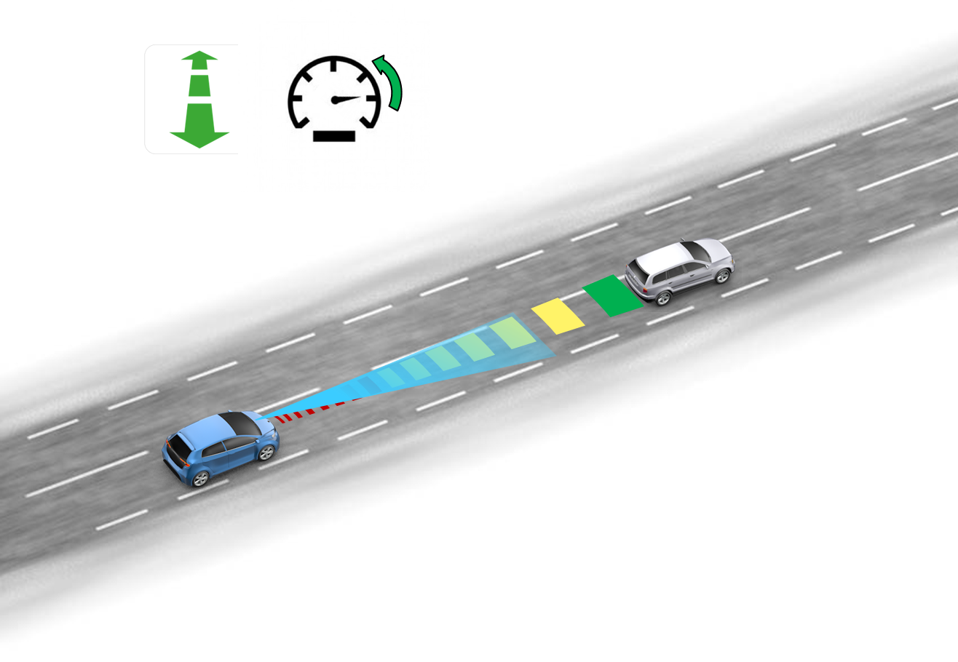
ACC
ACC Plus is a comfort system to be used when following the traffic flow. It will automatically adjust the speed of the ego vehicle when the traffic rhythm is changing in order to keep the driver-selected time gap to the lead vehicle. ACC legal only performs a longitudinal control of the vehicle, lateral controlling of the ego vehicle is up to the driver. Stop and go.
Parameter | Value
Detection range | 1 – 150 m
Activation Range (Ego Vehicle Speed) | 0 – 150 kph
Time headway | 0.8 – 2.2 s
Maximal Braking / Jerk | -4 m/s² -3 m/s³
Maximal Acceleration/ Jerk | 2.2 m/s² (20 m/s for 2s) 3.0 m/s³
Minimal Target | Motorcycle
Road type/environment | Motorway, highway, straight country roads, large urban roads, large curve radius, normal slope
2016 | 2017 | 2018 | 2019 | 2020
● | ● | ●
M
● | Vehicle Demo
● | Implemented in B-Sample
● | SOP Target
Notes:
Radar optinal

Slide 17

Object Detection
Key KPI:s
True Positives
Vehicle – Car, Truck
All 95%
Collision relevant 100% (NCAP scenarios)
Detection Distance 100 m
Pedestrians, bicyclists
All 80%
Collision relevant 100% (NCAP scenarios)
Detection Distance 50 m
False Positives collision relevant
Vehicle – Car, Truck
1 / 10 000 h
Pedestrian
1 / 5000 h

Slide 18
AEB
The purpose of AEB is to assist the driver in the case of an imminent front collision with another vehicle and VRU by an intuitive warning strategy and a brake support system. If a collision is unavoidable, AEB provides autonomous braking when the driver fails to respond to the imminent threat.
Overview
100°
Parameter | Value
Detection range | 100 m Vehicle. 60 m bicycle, 50 m adult, 30 m child
Activation Range (Ego Vehicle Speed) | 5-150 kph
Warning | Up to 1s TTC
Maximal Braking | 0.9G Customer demand
Maximal braking time | 1.4 s (Customer demand)
Minimal Target | Passenger car / Child
45°
MVS

Slide 19
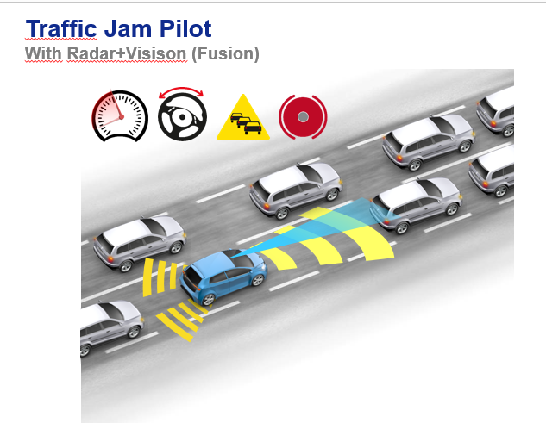
Traffic Jam Assist (Part of ICC)
Traffic Jam Assist provides with lateral and longitudinal guidance at low speeds. It follows to stop a target vehicle if no lane markings are available. Provides auto start in a short time. In case a lane can be detected, the lateral guidance is based on the lane marking. Driver supervision (i.e., hands on the steering wheel) is requested.
L1 L2 L3 L4 L5
Parameter | Value
Detection range | 0,5 – 150 m
Activation Range (Ego Vehicle Speed) | 0 – 40 kph
Time headway | ACC
Maximal Braking / Jerk | ACC
Driver steering angle | < 20 degrees
Driver steering torque | < 2,5 Nm
Minimal Target | Minimum allowed vehicle size on city road
Road type/environment | Lane marking required
M
Architecture

Slide 20
Intelligence Cruise Assist (Part of ICC)
Intelligence Cruise Assist provides with lateral and longitudinal guidance at high speeds. It follows to stop a target vehicle if no lane markings are available. Provides auto start. In case a lane can be detected, the lateral guidance is based on the lane marking. Driver supervision (i.e., hands on the steering wheel) is requested.
Parameter | Value
Detection range | 0,5 – 150 m
Activation Range (Ego Vehicle Speed) | 40 – 130 kph
Time headway | ACC
Maximal Braking / Jerk | ACC
Driver steering angle | < 20 degrees
Driver steering torque | < 2,5 Nm
Minimal Target | Minimum allowed vehicle size on city road
M
Road type/environment | highway/dual carriage road well-marked country roads with zero to moderate curvature.
Architecture

Slide 21
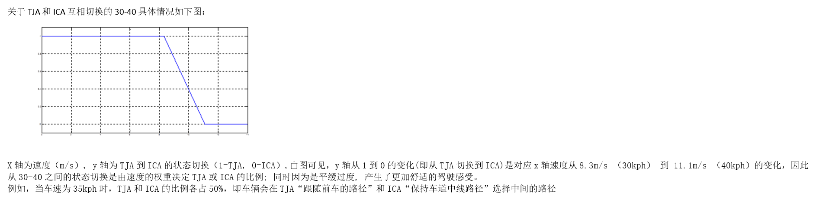
Change

Slide 22
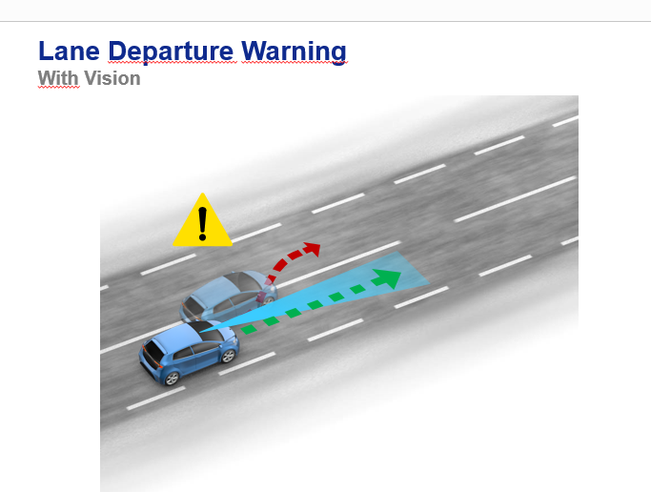
Lane Keeping Assist
The principle task of Lane Departure Prevention is to help the driver to stay in lane by warning the driver and applying an additional steering wheel torque on the steering column when the vehicle is about to leave the lane shortly. Thus, Lane Departure Prevention is a safety system that aims at reducing critical situations caused by unintentional lane departures.
Parameter | Value
Activation Range (Ego Vehicle Speed) | 60-130 kph
Lane marking type | All lane markings
Lane angle | <3 degrees
Curve radius outer circle | > 500 m
Driver steering angle | < 20 degrees
Driver steering torque | < 3 Nm
Relevant lane marking verified | > 0,3 x ego vehicle speed
Road type/environment | highway/dual carriage road well-marked country roads with zero to moderate curvature.
M
Architecture
Notes:
Velocity 60 below Traffic jam assis

Slide 23
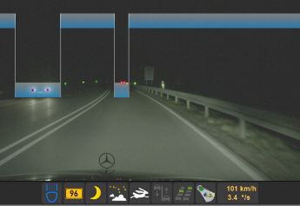
Intelligent High-Beam Control system (IHBC)
Available Functionality MVS Generation 3
Light source recognition
Detection and classification of light source
Situation Detection
City detection, motorway, tunnel detection, self-glare from traffic signs
High Beam Control/Marking Light

Slide 24






Speed Limit Information (SLIF)
Available Functionality MVS Generation 3
Traffic Sign Recognition
Detection and classification of a wide range of traffic signs
Map Data Fusion
Electronic horizon reconstruction (ADASIS Interface)
Customer Functions
Display Traffic Signs
Speed Limit Assist
Examples of detected signs
Speed Limit
Zone incl. ”Zone-text”

Slide 25
Thank You!

